Slide 1
Fake News Detection System
AI-Powered Detection using Flask, Machine Learning, and React
-by Abhrojit Bhattacharyya and Moksh Pandit

Slide 2
Project Overview
• Flask backend provides a REST API for ML predictions
• React frontend for interactive and modern UI
• Logistic Regression model trained on Kaggle datasets
• Real-time predictions with TF-IDF vectorization

Slide 3
Problem Statement
• The rapid spread of misinformation online has major social and political impacts.
• Manual verification is inefficient and time-consuming.
• Need for automated, reliable fake news detection system using AI.

Slide 4
Dataset used for training
Source:
Fake news detection dataset (Kaggle)
Total articles: 44,000+
Fake articles: 21,000+
Real articles: 23,000+

Slide 5
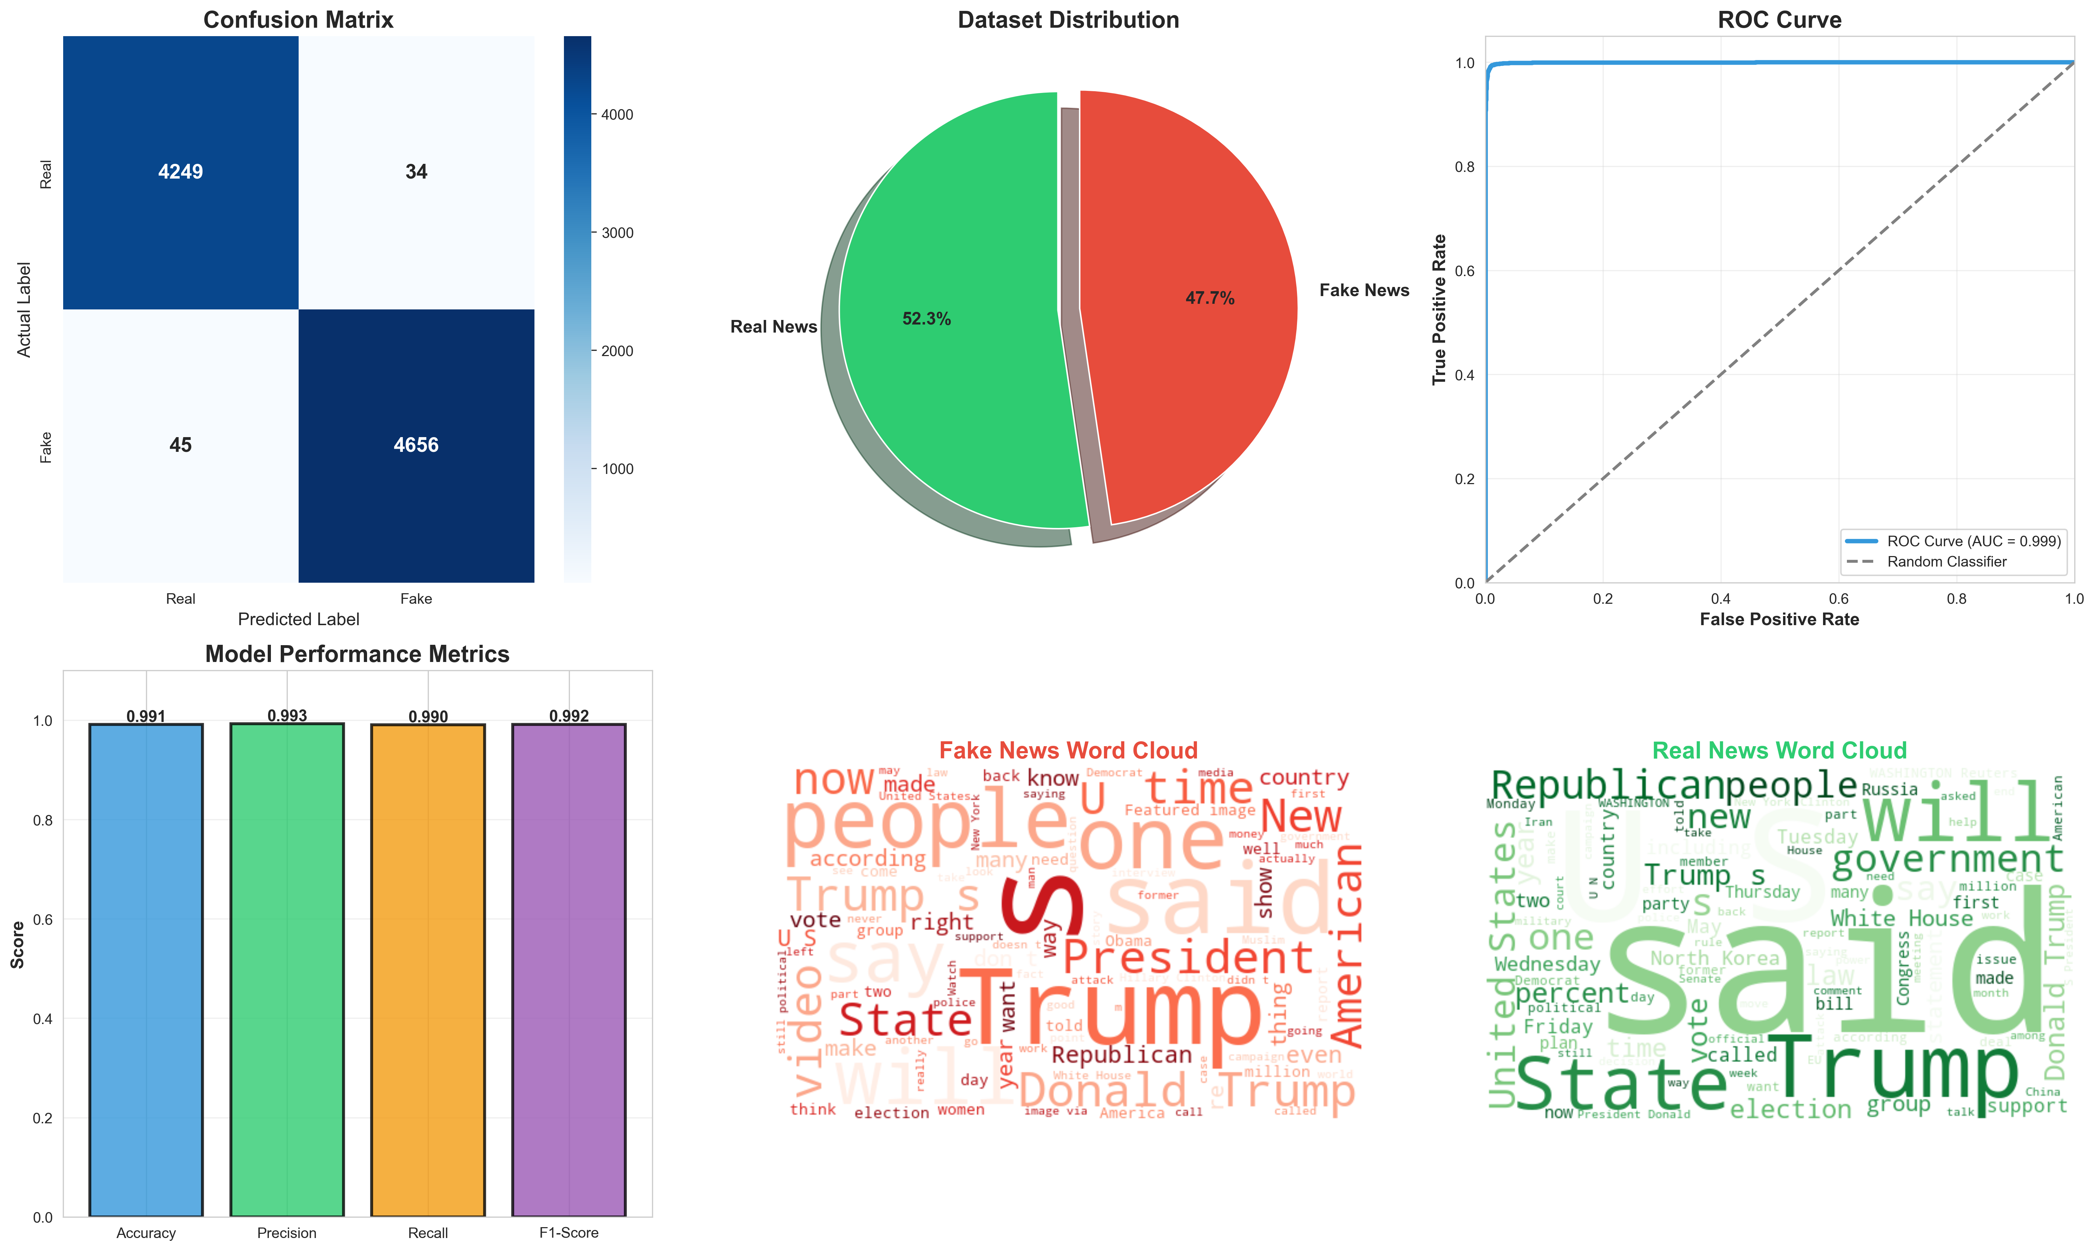
Fake vs real news distribution:

Slide 6
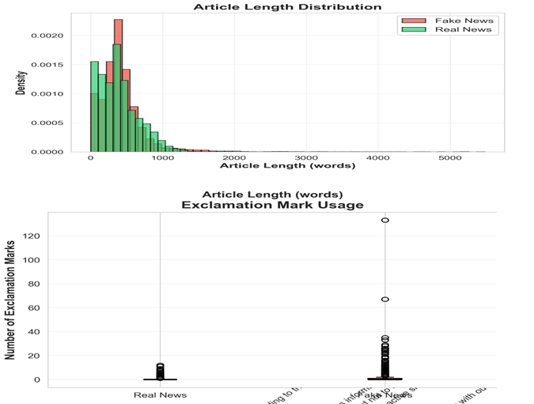
DETAILS OF ARTICLES IN DATASET
This graph shows us that:
>Fake news articles have a larger range of words from 200-1000 words, while Real news articles have a smaller range of 200-600 words, likely due to a lot more filler content in fake news articles
>Very large articles(1300-2000 words) are almost always fake

Slide 7
This graph shows us:
>Fake news articles use a lot more exclamation marks in comparison to real news articles
>Real news articles use barely any exclamation marks, as they adhere to professional journalistic standards

Slide 8
This word cloud shows the most frequent words used in the fake news articles dataset
This word cloud shows the most frequent words used in the real news articles dataset

Slide 9
Backend (Flask Application)
• Flask REST API for model training and predictions
• Endpoints:
- /api/predict → Predict fake or real news
- /api/stats → Retrieve model performance metrics
- /api/retrain → Retrain model with updated datasets
• Saves trained model and TF-IDF vectorizer using Pickle

Slide 10
Machine Learning Model
• Text preprocessing includes cleaning URLs, punctuation, and hashtags
• TF-IDF Vectorizer extracts features from text
• Logistic Regression classifier predicts fake vs. real
• Model evaluated on Accuracy, Precision, Recall, and F1-score

Slide 11
WHY USE TF-IDF AND LOGISTIC REGRESSION?
First some explanations:
TF-IDF vectorization:
It is useful to identify meaningful words, reduce noise(words like: is, the etc) and help the model focus on informative words
TF(Term frequency): it measures how often a word appears in an article, but it alone is not enough, as some other common words(eg- news, breaking etc) appear quite frequently
IDF(inverse document frequency): It measures the rarity or uniqueness of a word, across the entire dataset, the formula for it is log(N/n), where N is the total number of documents and n is the number of documents containing the term
Combining these two functions tells how important a word is in a specific document, a high TF-IDF score would indicate the word appears frequently in a specific article, but is rare across the dataset, making it very important, while ignoring words with a low score
Why it works?: TF-IDF helps the model to detect linguistic differences between fake news and real news, for example, a real news article contains more neutral terms and professional vocabulary, while fake news articles contain sensational words and misleading terms like “outrageous”,”Secret” etc

Slide 12
Logistic regression:
While it’s name has regression, it is actually a classification model
It is excellent at finding patterns
It assigns weights to words based on how strongly the word correlates to fake or real news, which gets more accurate every time it trains
It puts the weights and TF-IDF scores of words through a linear equation, and turns the result of that equation into a probability through another, which tells us if the article is fake or real
Why use them both together?:
→TF-IDF turns text into a vector of meaningful numbers, in which important words get higher value, and common words get a lower value, giving logistic regression clean, weighted inputs
→Logistic regression works well with sparse matrices(i.e. mostly zeroes in the matrix) which is what TF-IDF gives it. So it efficiently learns which words indicate strongly whether an article is fake or real
→ Logistic regression trains very quickly, making it work well for website deployment and makes it easy for computers without GPUs to run the program

Slide 13
Frontend (React Application)
• Developed using React and Tailwind CSS
• Connects to Flask backend for real-time predictions
• Displays live model metrics (accuracy, F1-score, etc.)
• Interactive design with example news articles and visual confidence bars

Slide 14
System Workflow
User inputs news text on the frontend
Text sent to Flask backend via POST request
Text cleaned and transformed using TF-IDF
Logistic Regression model predicts authenticity
Frontend displays result with confidence levels

Slide 15
Technologies Used
🔹 Backend: Python, Flask, Pandas, Scikit-learn
🔹 Frontend: React.js, Tailwind CSS, Babel
🔹 Model Storage: Pickle
🔹 Communication: RESTful APIs with JSON

Slide 16
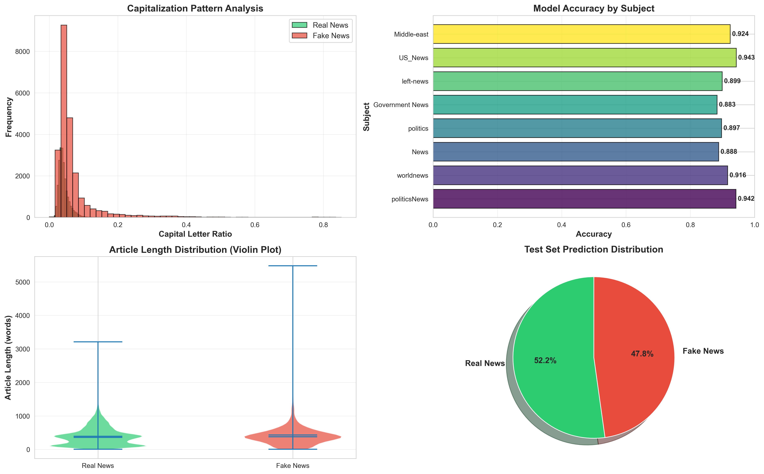
Test set distribution

Slide 17
Model Results & Performance
→The model showed a very low rate of false positives and false negatives, as showcased by the confusion matrix given above

Slide 18
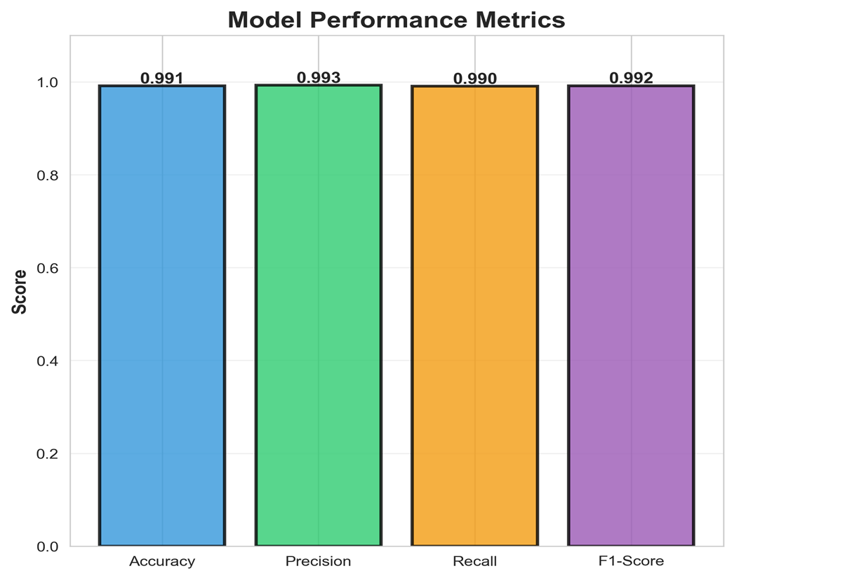
→Accuracy: It is measuring the percentage of total correct predictions
→Precision: It showcases how many fake articles were correctly predicted as fake by the model, tells us how often false positives occur
→Recall: It shows how many actual fake articles were detected successfully, tells us how often false negatives occur
→F1 score: it is the harmonic mean of precision and recall, gives a overall metric to how often the model makes a mistake
In this model, we see all the metrics are above 95%, so it can be trusted to make the right predictions, though mistakes are still possible

Slide 19
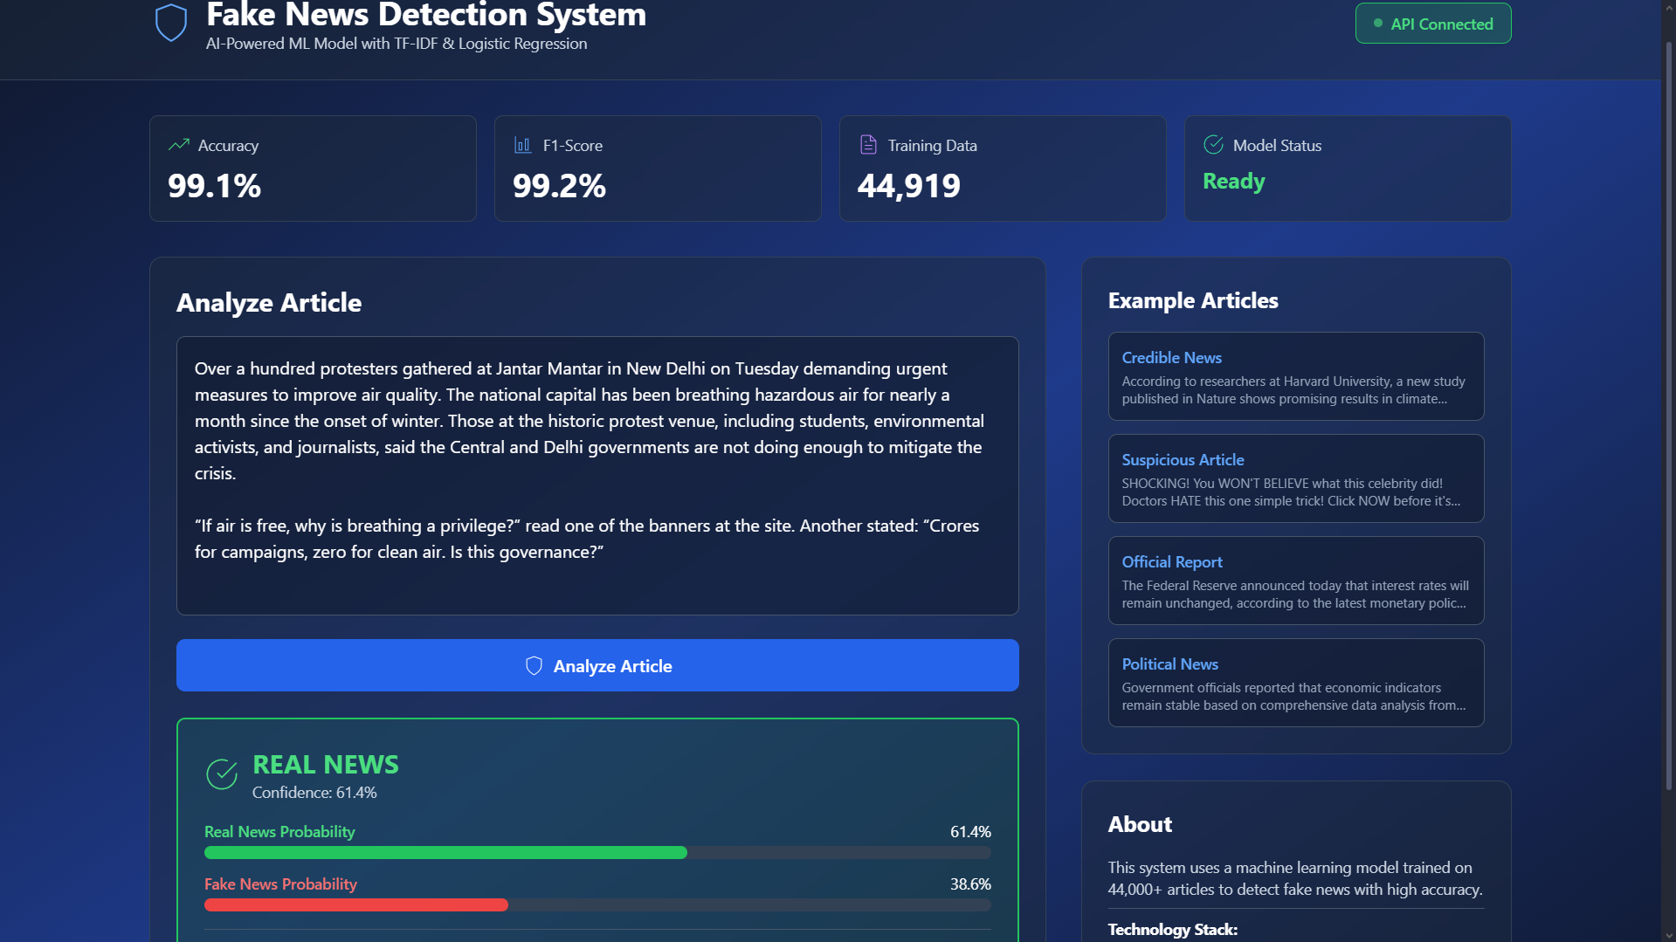
Running the model
Given above is a real news article taken from “The Hindu” as input into the website with the model deployed, as we can see the model was able to correctly identify the article as Real news.

Slide 20
Conclusion
Combines Machine Learning and Web Development effectively
Provides real-time AI-powered verification of news authenticity
Demonstrates full-stack integration of Flask and React
Scalable solution for combating misinformation online

